Slide 1

Home Credit: Accurate Loan Repayment Predictions with ML
Yayuan Zhang, Peiling Zou
ISM 6354: Programming for Data Analytics R
Prof. Andy Chen
Notes:
Hello everyone. It's great to be here today to talk about a topic that affects millions of people worldwide - getting loans with insufficient or non-existent credit histories. As you may know, this is a significant issue that can have far-reaching consequences for individuals and families alike. But the good news is that technology can help us tackle this challenge. Today, we are happy to share our team's work on predicting loan repayment with machine learning model.

Slide 2





broaden financial inclusion
Home Credit Group
An International consumer finance provider – 8 countries
Provided Credit Loans & related financial services
Individuals who aren’t trusted by traditional credit institutions
Self-employed
Low-income
Financial inclusion
Background
Business Problem
Stakeholders
Data
Recommend Model
Ethical Problems
Notes:
Home Credit is an international consumer finance provider with operations in eight countries. and focus on responsible lending primarily to people with little or no credit history. such as self-employed and low-income individuals.

Slide 3






Business challenges
Assess the default risk of their clients before issuing loans
If clients are unable to repay on time –
Financial losses
Negative impact on reputation
Reduce customers’ trust
Background
Business Problem
Machines learning & Data Analysis​
​
​
Develop an accurate predictive model to better understand their clients’ financial status and likelihood of on-time repayment.​
Stakeholders
Data
Recommend Model
Ethical Problems
Notes:
The main challenge faced by Home Credit is how to accurately assess the default risk of their clients before issuing loans. to avoid facing financial losses or negative impacts if their customer are unable to repay on time. So Home Credit need machine learning and data analysis techniques to develop an accurate predictive model to better understand their client's financial status and take appropriate measures.

Slide 4



Who are the Stakeholders
Home Credit Management Team
Ensure the company’s financial stability and ensure the underserved population has a positive loan experience.​
Risk Management Team
Minimize the risk of default as much as possible and avoid negative impact on reputation.​
Qualified loan applicants
Individuals who are not trusted by traditional credit institutions. ​
Background
Business Problem
Stakeholders
Data
Recommend Model
Ethical Problems
Notes:
The project has three main stakeholders group. Home Credit's management team and risk management team want to ensure the company's financial stability and minimize the risk as much as possible. Qualified loan applicants may have the opportunity to get a loan application.

Slide 5
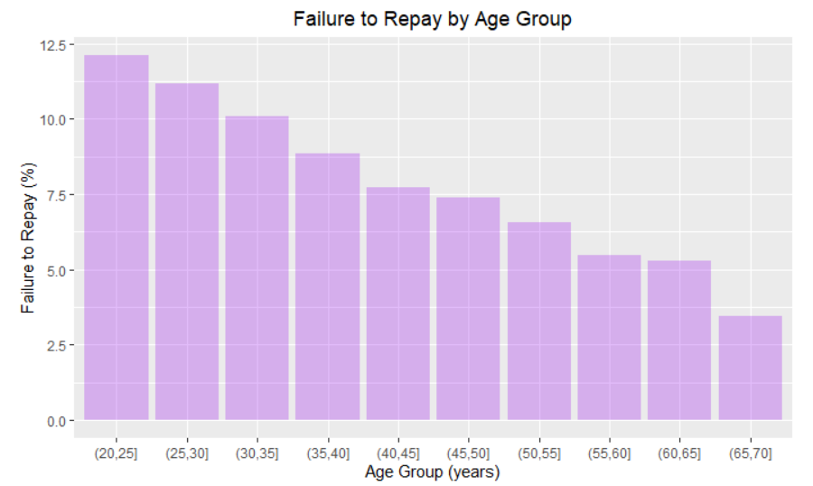
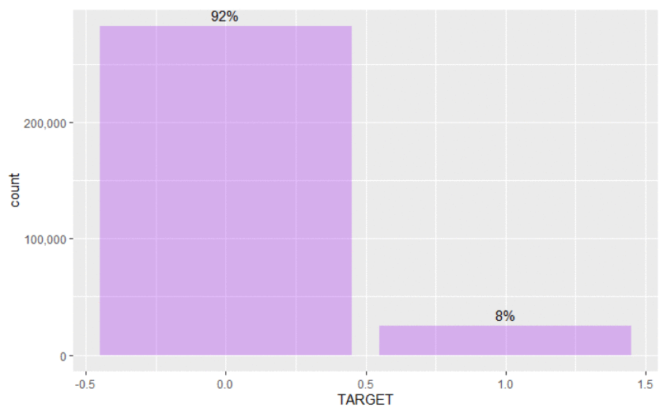
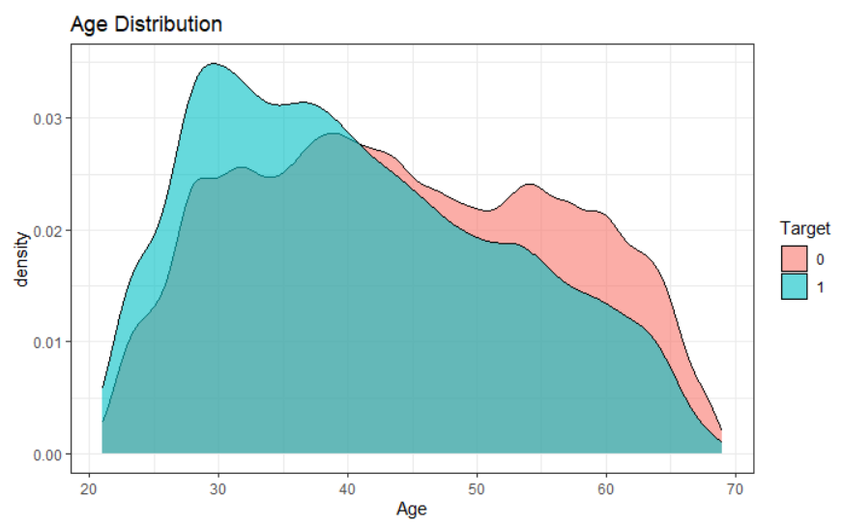
Insight
Age on repayment
Kaggle Featured Prediction Competition
90.5% loans – Cash loans
63.9% married applicants
18% Pensioner - 56% working
Top applicants –
Laborers 55K, Sales Staff 32K, Core staff 28K
Organizations types –
Business entity 68K, Self employed 38K, Medicine 11K
Delayed to repayment curve skews towards younger end of range.
307511 data points & 122 features
Cut AGE category into bins of 5 years each
Each row represents Gender, Education, Family status,
Flag for car or house, if have job, etc
Calculating average value of the target
Rate of failure to repay is above 10% - youngest 3 groups,
Below 5% for the oldest age group in case
Imbalanced class problem: 92% repay on time, 8% not on time
Threshold adjustment & XGBoosting
Area Plot
Bar Plot
Pie Plot
Area Plot
Bar Plot
Histogram
Heatmap
Background
Business Problem
Stakeholders
Data
Recommend Model
Ethical Problems
Notes:
The data come from a competition on Kaggle for Home Credit. The dataset contains around 300,000 samples, where each has 122 attributes. In this dataset, 92% of applicants repay the loan on time, and 8% of applicants don't. There is an imbalanced data problem. We will talk later about how to handle this issue in the model using several techniques such as threshold adjustment and XGBoosting.
In the exploratory data analysis (EDA), we further understood the information in the dataset and gained some insight. The dataset is mostly cash loans, and more than half of the applicants are married. More than half of the applicants have jobs, with the most significant number of applicants engaged in laborers, sales, and core staff's work. The most frequent type of organization applying is a business entity.
When exploring the effect of age on repayment, we found that the target == 1 curve skews towards the younger end of the range. Therefore, we cut the age category into bins of 5 years each, calculated the average value of the target for each bin. We found The rate of failure to repay is above 10% for the youngest three age groups and below 5% for the oldest age group.

Slide 6
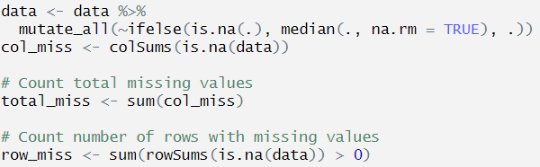
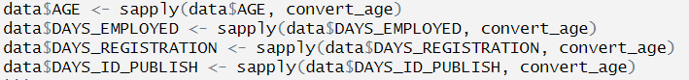
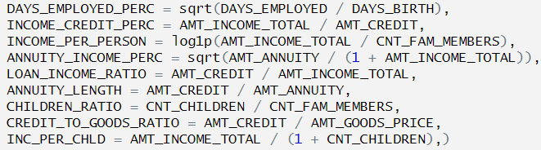
Drop outsource features
Selecting relevant features according to Heatmap’s correlation 0 < X < 0.8
61 columns has missing values
22.4% missing observations
Negative values
Convert to positive years
Accuracy & performance
Fetch complex relationship
Remove & Selecting
Imputing Missing values with median values
Handling Outlier values
Creating new 9 features
Data Pre-processing
Background
Business Problem
Stakeholders
Data
Recommend Model
Ethical Problems
Notes:
In the data pre-processing, we performed four key steps to prepare the data for the model. We dropped all outsource features and selected relevant features according to the heatmap. We filter out the correlation values greater than 80% to avoid overfitting.
The original dataset had 61 columns missing values, and 22.4% missing observations, so we imputed the missing values with the median values of their features.
We also noticed four features displaying negative values, indicating the number of days before the application submission date, such as negative values on the Birth variable indicating that the applicant was born before how many days of application. We convert the negative values as days to positive values as years.
Additionally, we added nine new features based on the original dataset's features to improve the model's accuracy and performance, as the original features may not capture the complex relationships between the target variables. For example, The DAYS_EMPLOYED_PERC feature (percentage of client's lifespan that they have been employed) could be a useful measure of employment stability, which is an important factor in assessing a client's ability to repay a loan.

Slide 7
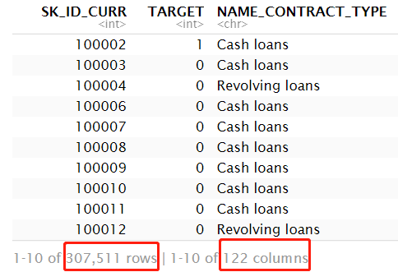
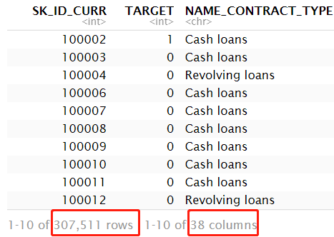
BEFORE AFTER
307511 rows 122 columns
307511 rows 38 columns
Background
Background
Business Problem
Business Problem
Stakeholders
Stakeholders
Data
Data
Recommend Model
Recommend Model
Ethical Problems
Ethical Problems
Notes:
Before we drive into the model part, 我们检查了经过处理后带入模型的数据集。
经过数据预处理，我们的数据集从122个features整理成38个。包含9个新features。

Slide 8
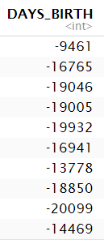
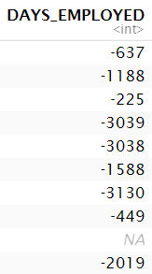
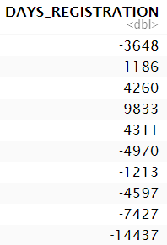
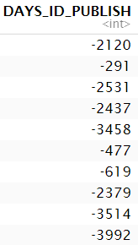
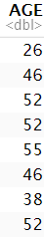
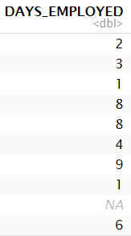
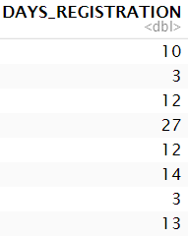
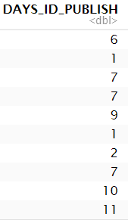
BEFORE AFTER
Outlier – Negative values.
Positive values. Convert to year.
Background
Background
Business Problem
Business Problem
Stakeholders
Stakeholders
Data
Data
Recommend Model
Recommend Model
Ethical Problems
Ethical Problems
Notes:
We converted negative values in days to positive values and display the year为单位以更好地表达其含义。

Slide 9
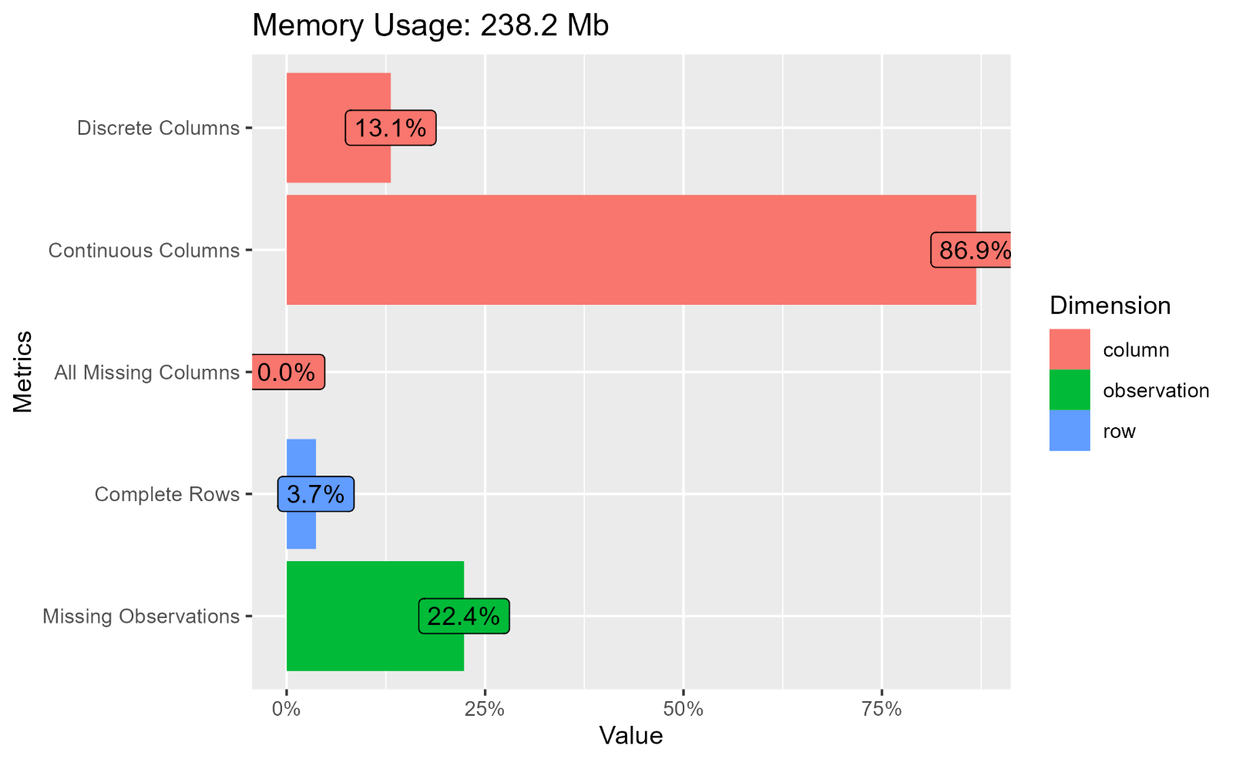
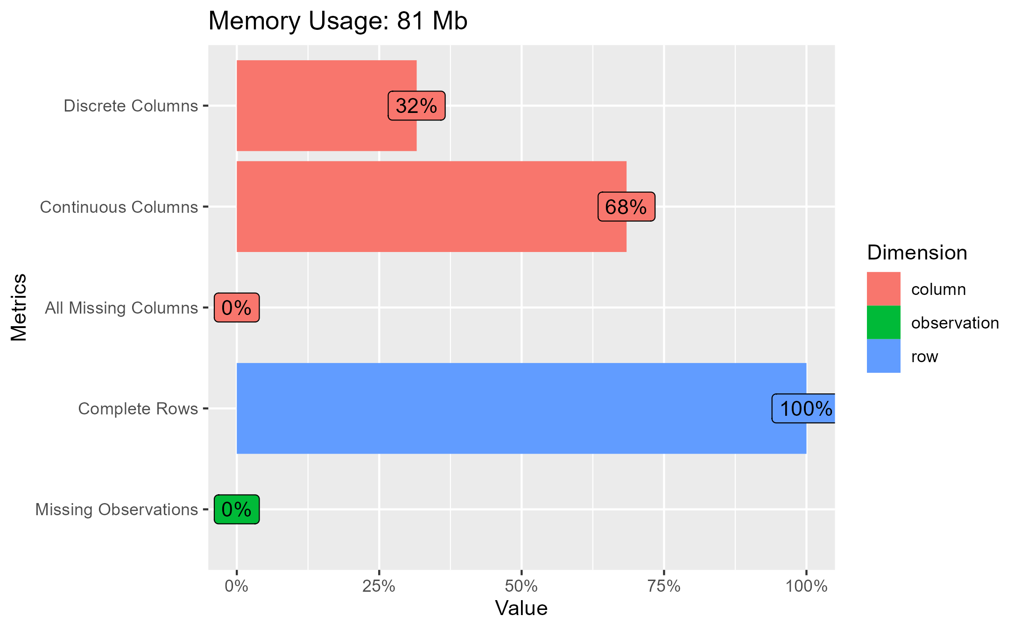
BEFORE AFTER
22.4% missing observation. 3.7% complete rows
0% missing observation. 100% complete rows
Background
Background
Business Problem
Business Problem
Stakeholders
Stakeholders
Data
Data
Recommend Model
Recommend Model
Ethical Problems
Ethical Problems
Notes:
填充了22.4%的丢失observation。每一行完成度提升到100%。

Slide 10
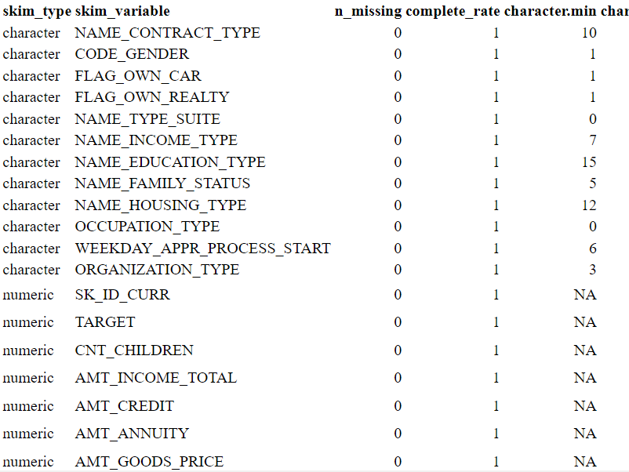
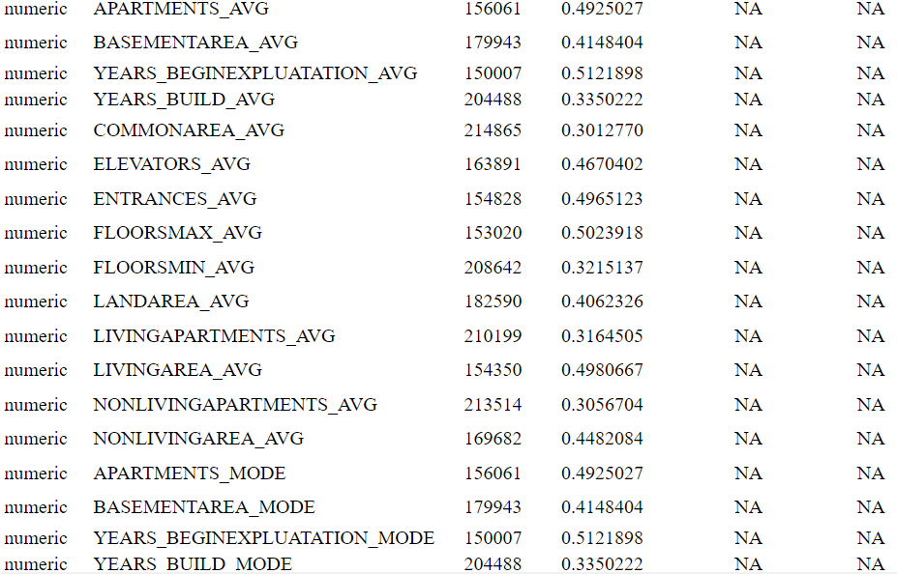
BEFORE AFTER
Each columns missing values
Each columns complete rate = 1
Background
Background
Business Problem
Business Problem
Stakeholders
Stakeholders
Data
Data
Recommend Model
Recommend Model
Ethical Problems
Ethical Problems
Notes:
从这两个table可以清晰的看到每一行的complete rate都在1， which is no missing values anymore in each row.

Slide 11
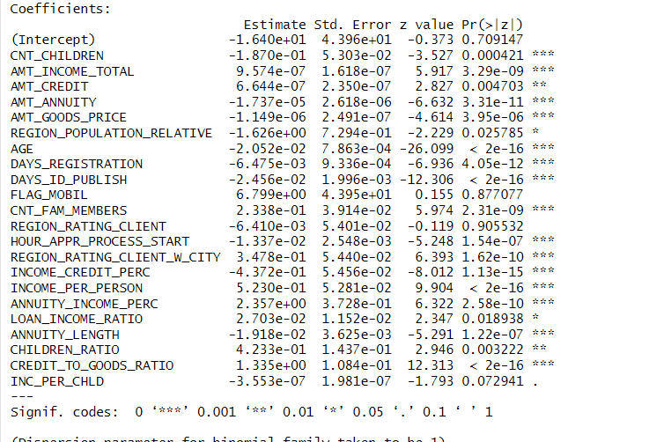
Logistic Regression
Predict the likelihood of a client defaulting on a loan based on a variety of demographic, financial, and credit-related factors etc., which help financial institutions make informed decisions about whether to grant loans to potential clients and reduce the risk of financial losses
Purpose
Steps
Define the model
Modeling the probability binary outcome based on one or more predictor variables
Collect Data
Clients’ demographic, financial, credit-related information
Modeling
Split the data into training and testing set
Result
F1 score: 0.958, Recall: 1.0, Accuracy: 0.919 AUC: 0.6
Background
Business Problem
Stakeholders
Data
Recommend Model
Ethical Problems
Notes:
So let’s jump into our main analysis, the first model we use is Logistic Regression
The purpose of this model is to predict the likelihood of a client defaulting on a loan based on a variety of demographic, financial, and credit-related factors. This model will help financial institutions make informed decisions about whether to grant loans to potential clients and reduce the risk of financial losses.
Steps:
Define the Model: Logistic regression is a statistical method used for modeling the probability of a binary outcome based on one or more predictor variables. In this case, we will be using logistic regression to model the probability of loan default based on various client attributes.
Collect the Data: we using heatmap to check which variables has high correlation and avoid using them can reduce overfitting, the data including clients’ demographic information (such as age, gender, and family status), financial information (such as annually income )and credit-related information (such as credit scores).
Modeling: Split the data into training and testing set, Adjust the threshold for handling imbalanced data
Result:
Coefficient: we can check which P value is < 0.05 and it can consider the coefficient is statistically significant. For example:
For every unit increase in a client's income, the log-odds of paying the loan on time increase by the coefficient value 9.574e-07, which means the higher income the more likely the client can pay the loan on time
For every unit increase in a client's age, the log-odds of not paying the loan on time decrease by 0.021 which means the older client gets the more likely the client can pay the loan on time
Finally we can see F1 score: 0.958 and Recall: 1.000 indicate that the model is good at identifying positive cases, with a high balance between precision and recall, and that the model identified all actual positive cases in the dataset.
The Accuracy: measures the overall accuracy of the model in predicting both positive and negative cases. It shows the model correctly classified 92% of all cases.
However, AUC suggests that the model's ability to distinguish between positive and negative cases is better than random guessing, but not strong and can be considered overfitting to the positive cases

Slide 12
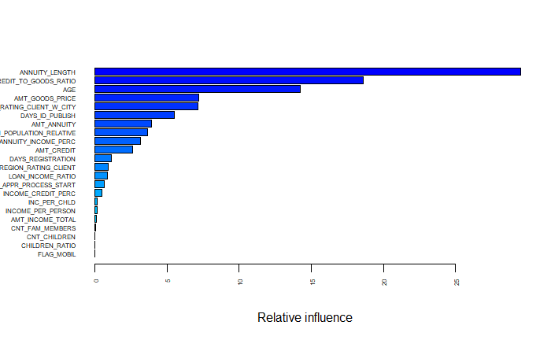
Stochastic Gradient Boosting
Purpose
analyze various factors make predictions about the likelihood of loan default
handle imbalanced data by assigning different weights to the different classes
Steps
Define the model
model's parameters, number of trees, learning rate, and depth of each tree
Collect Data
Clients’ demographic, financial and credit-related information
Analyze
Feature Importance
Result
Accuracy : 0.92 , AUC:0.7
Background
Business Problem
Stakeholders
Data
Recommend Model
Ethical Problems
Notes:
The second model we used is Stochastic /stəˈkastik/ Gradient Boosting:
Same as Logistic regression Purpose of this model is to analyze various factors make predictions about the likelihood of loan default.
One of the challenges is that the data is highly imbalanced. This means that the number of individuals who do pay loan on time is much higher than the number of individuals who do default. Handling imbalance data is essential because it can lead to bias in the model and inaccurate predictions. The advantage of using Stochastic /stəˈkastik/ Gradient Boosting is it can handle imbalanced data by assigning different weights to the different classes.
Steps:
Define the model: define the model's parameters, which including selecting the number of trees, the learning rate, and the depth of each tree
Collect Data: Same as what we did in Logistic Regression, the data including clients’ demographic, financial and credit-related information
After modeling, we will get feature importance chart which shows that the top 5 relative influenced attributes are
Annuity length: The length of the client's annuity payment, measured in months
Credit to goods ratio: Ratio of the amount of credit customers apply for to the price of the goods they purchase with the credit
Age
Amount good Price: For consumer loans it is the price of the goods for which the loan is given
Rating client with city: Home credit’s system rating of the region where client lives with taking city into account
Result: Accuracy : It means model correctly classified 92% of all cases , AUC:0.7 considered as acceptable model which is better than logistic regression

Slide 13
Business Problems
Optimize loan approval rates
Customer segmentation
Risk management
Loan Recovery
Thank you
Questions?
References
https://www.kaggle.com/datasets/pavansubhasht/ibm-hr-analytics-attrition-dataset
Background
Business Problem
Stakeholders
Data
Recommend Model
Ethical Problems
Notes:
Here are some Business problems that could be solved using this Home Credit Default Risk data
1. Optimize loan approval rates. Home Credit may want to approve as many loan applications as possible while minimizing the risk of default. As Data analytics we can develop models that balance these two goals and determine which applicants are most likely to repay their loans.
2. Improve customer segmentation. Home Credit can identify different groups of clients with unique characteristics and behaviors.
3. Enhance risk management. By determining which factors are most closely associated with the risk of default, Home Credit can develop risk management strategies to mitigate those risks. For example, Home Credit can adjust their lending policies or loan terms based on an applicant's risk profile instead of just rejecting their applications.
4. Improve loan recovery. Home Credit can develop more effective loan recovery strategies, such as proactively contacting high-risk customers or personalizing repayment plans.

Slide 14

Ethical Implications and Christian Faith
Privacy Concerns
Data Transparency
Fairness and Bias
Christian Faith: As DA, potential ethical implications of the work and to act in a way that upholds Christian values of dignity, respect, privacy, and justice
"Speak up for those who cannot speak for themselves, for the rights of all who are destitute. Speak up and judge fairly; defend the rights of the poor and needy." - Proverbs 31:8-9
Background
Business Problem
Stakeholders
Data
Recommend Model
Ethical Problems
Notes:
Here are some ethical implications and Christian faith
Privacy Concerns:
The dataset contains sensitive information about clients, including their demographic, financial, credit-related information, these data need to get protected and prevent data breaches. Even though this is open source and home credit didn’t show client’s names, but it’s possible these datasets at Home credit could be misused for other purposes, Data may be used to target vulnerable individuals for predatory lending practices or to make decisions about an individual's creditworthiness without their knowledge or consent. As data analytics and Home credit executives, t is important to ensure that data is used ethically and for the intended purpose and also it is important to ensure that individuals whose data are included in the dataset have provided informed consent to how their data will be used with respect.
Data Transparency: It is important to ensure transparency of the algorithms used in the data analysis process. This includes being transparent about the sources of data and the methods used to analyze the data, as well as being accountable for any decisions made based on the analysis.
Fairness and Bias: The data set has the potential to contain bias, either through the selection of attributes or the sampling of individuals.This can lead to unfair or discriminatory results, especially if the model is used to make decisions about an individual's financial future. As DAs or executives, it is important to identify and address any potential sources of bias to ensure that the model is fair and equitable.
Connecting to Christian faith at the end, As DA, potential ethical implications of the work and to act in a way that upholds Christian values of dignity, respect, privacy, and justice.
Here is a quote from bible "Speak up for those who cannot speak for themselves, for the rights of all who are destitute. Speak up and judge fairly; defend the rights of the poor and needy." - Proverbs 31:8-9

Slide 15

Challenges
Imbalanced data
282,686 rows in the majority class (paying the loan on time)
24,825 rows in the minority class (not paying the loan on time)
Imitations
Technical issues
Large number of features
Thank you
Questions?
References
https://www.kaggle.com/datasets/pavansubhasht/ibm-hr-analytics-attrition-dataset
Background
Business Problem
Stakeholders
Data
Recommend Model
Ethical Problems
Notes:
We also facing some challenges when doing the process
In this case, there are too many rows in the majority class (paying the loan on time) and less rows in the minority class (not paying the loan on time).
This shows that this is a highly unbalanced dataset, with the minority class accounting for only about 8.1% of the majority class. To deal with this unbalanced dataset, you can try using a threshold below 0.5 and we set to 0.3, which will increase the probability of classifying the sample as a minority class.
Limitations: The dataset contains a large number of features, and some of them may not be useful for predicting loan defaults. It is also a very large dataset and the training data connected to other external sources and we need left join multiple datasets, we also faced couple R session crashing due to this, so in this case we removed all the external source variables to finish the project easier. In the future, it may be beneficial to re-run the project with the complete datasets to develop more accurate prediction models.

Slide 16

Any feedback?

Slide 17
THANK YOU

